Slide 1
Static keyword in java
The static keyword in Java is used for memory management mainly.
We can apply static keyword with variables, methods, blocks and nested classes. The static keyword belongs to the class than an instance of the class.
The static can be:
Variable (also known as a class variable)
Method (also known as a class method)
Block
Nested class

Slide 2
Java static variable
If you declare any variable as static, it is known as a static variable.
4.5M
489ackage in Java
The static variable can be used to refer to the common property of all objects (which is not unique for each object),
for example, the company name of employees, college name of students, etc.
The static variable gets memory only once in the class area at the time of class loading.
Advantages of static variable
It makes your program memory efficient (i.e., it saves memory).

Slide 3
Understanding the problem without static variable
class Student{
int rollno; String name;
String college="ITS";
}
Suppose there are 500 students in my college, now all instance data members will get memory each time when the object is created. All students have its unique rollno and name, so instance data member is good in such case. Here, "college" refers to the common property of all objects. If we make it static, this field will get the memory only once.

Slide 4
Example of static variable
class Student{
int rollno;//instance variable
String name;
static String college ="ITS";//static variable
Student(int r, String n)
{ rollno = r; name = n; }
void display () { System.out.println(rollno+" "+name+" "+college);} }
public class TestStaticVariable1{
public static void main(String args[])
{ Student s1 = new Student(111,"Karan"); Student s2 = new Student(222,"Aryan");
s1.display(); s2.display();
} }

Slide 5
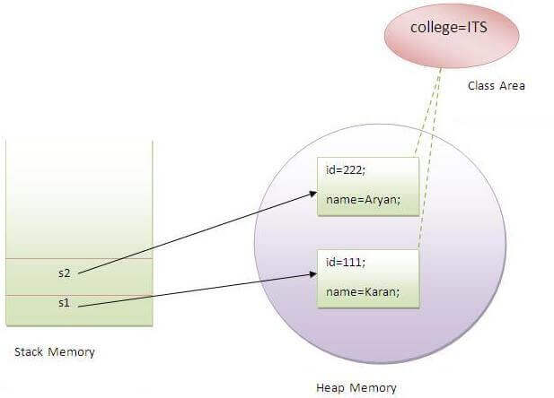
Output:
111 Karan ITS
222 Aryan ITS

Slide 6
Program of the counter without static variable
//Java Program to demonstrate the use of an instance variable
//which get memory each time when we create an object of the class.
class Counter{
int count=0;//will get memory each time when the instance is created
Counter(){
count++;//incrementing value
System.out.println(count);
}
public static void main(String args[]){ //Creating objects
Counter c1=new Counter(); Counter c2=new Counter();
Counter c3=new Counter(); }
}

Slide 7
In the above example, we have created an instance variable named count which is incremented in the constructor. Since instance variable gets the memory at the time of object creation, each object will have the copy of the instance variable. If it is incremented, it won't reflect other objects. So each object will have the value 1 in the count variable.

Slide 8
Program of counter by static variable
As we have mentioned above, static variable will get the memory only once, if any object changes the value of the static variable, it will retain its value.
//Java Program to illustrate the use of static variable which is shared with all objects.
class Counter2{
static int count=0;//will get memory only once and retain its value
Counter2(){
count++;//incrementing the value of static variable
System.out.println(count);
}
public static void main(String args[]){
Counter2 c1=new Counter2();
Counter2 c2=new Counter2();
Counter2 c3=new Counter2(); }
}

Slide 9
Java static method
If you apply static keyword with any method, it is known as static method.
A static method belongs to the class rather than the object of a class.
A static method can be invoked without the need for creating an instance of a class.
A static method can access static data member and can change the value of it.

Slide 10
class Student{
int rollno;
String name; static String college = "ITS"; //static method to change the value of static variable static void change(){
college = "BBDIT"; } //constructor to initialize the variable Student(int r, String n){
rollno = r;
name = n;
}
//method to display values
void display(){System.out.println(rollno+" "+name+" "+college);} }
//Test class to create and display the values of object

Slide 11
public class TestStaticMethod{
public static void main(String args[]){
Student.change();//calling change method
//creating objects
Student s1 = new Student(111,"Karan");
Student s2 = new Student(222,"Aryan");
Student s3 = new Student(333,"Sonoo"); //calling display method
s1.display();
s2.display();
s3.display();
}
}

Slide 12
There are two types of modifiers in Java: access modifiers and non-access modifiers.
The access modifiers in Java specifies the accessibility or scope of a field, method, constructor, or class. We can change the access level of fields, constructors, methods, and class by applying the access modifier on it.
There are four types of Java access modifiers:
Private: The access level of a private modifier is only within the class. It cannot be accessed from outside the class.
Default: The access level of a default modifier is only within the package. It cannot be accessed from outside the package. If you do not specify any access level, it will be the default.
Protected: The access level of a protected modifier is within the package and outside the package through child class. If you do not make the child class, it cannot be accessed from outside the package.
Public: The access level of a public modifier is everywhere. It can be accessed from within the class, outside the class, within the package and outside the package.
There are many non-access modifiers, such as static, abstract, synchronized, native, volatile, transient, etc. Here, we are going to learn the access modifiers only.

